Slide 1
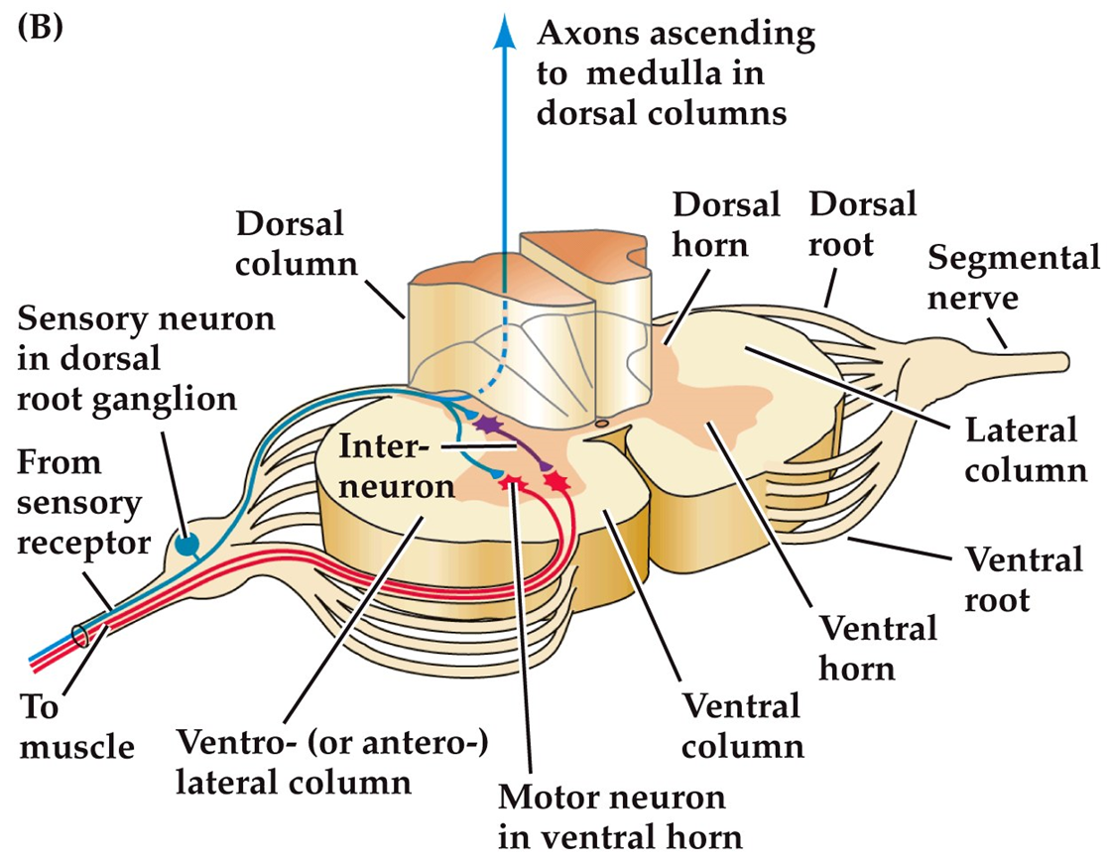
Some motor commands originate in the Spinal cord
Reflex: a simple, unvarying, unlearned response to sensory stimuli
  Ex. Knee jerk reflex
Central pattern generator: neural circuitry responsible for rhythmic behavior, such as walking.

Slide 2
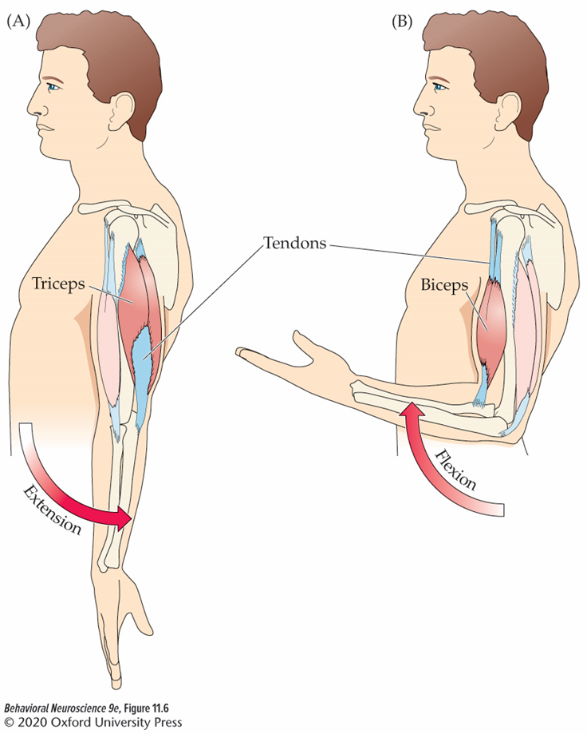
Muscle Pairs
Many muscles work in antagonistic pairs.
  when one contracts, the other extends/lengthens.
  Flexor muscles contract to bend or flex a joint. (e.g. biceps)
  Extensor muscles extend or straighten a limb or other part of the body when they contract. (e.g. triceps)

Slide 3
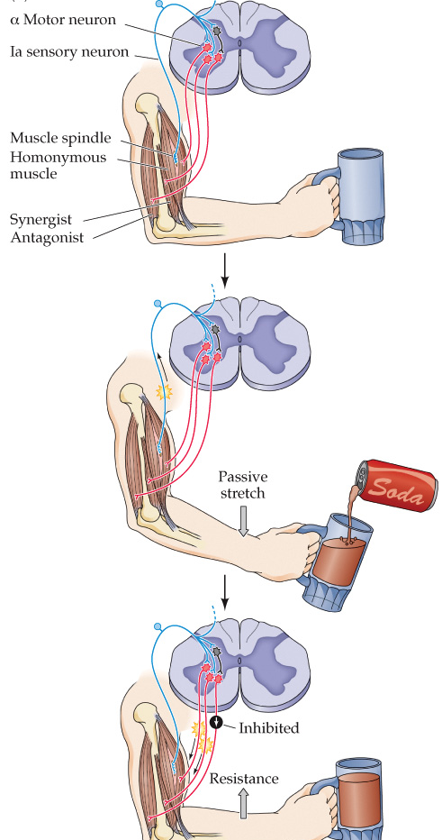
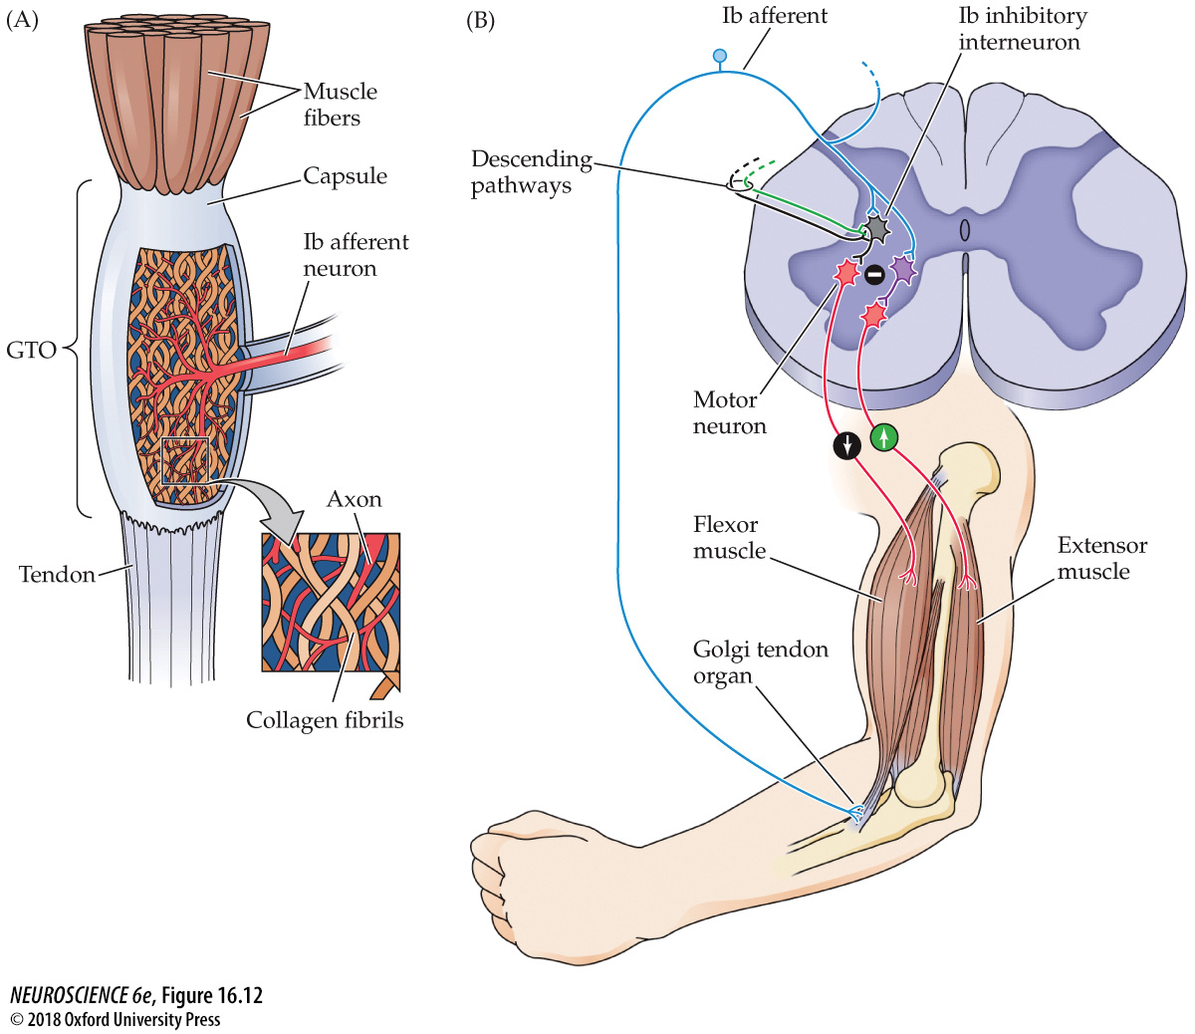
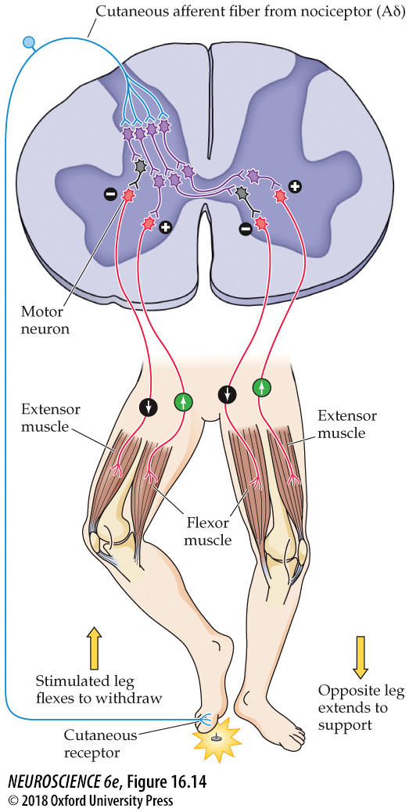
Spinal reflexes
Stretch Reflex
passive stretching
Flexion Reflex
away from pain
Golgi Tendon Reflex
muscle tension

Slide 4
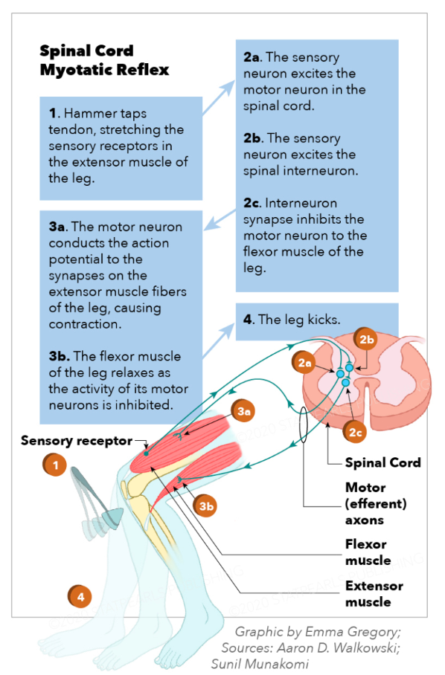
The Stretch Reflex
Stretching a muscle spindle increases activity in Ia afferents and subsequently α motor neurons that innervate the same muscle.
Activity of the sensory afferent also excites interneurons that inhibit motor neurons innervating antagonist muscles.
High gain reflexes only need a small amount of stretch to influence many motor neurons.
  Ex. Knee jerk
Low gain reflexes require a greater amount of stretch to generate a similar degree of motor neuron recruitment.
  Ex. Weight change of a held object
https://www.ncbi.nlm.nih.gov/books/NBK551629/#:~:text=The%20myotatic%20reflex%20begins%20when,a%20muscle%20or%20muscle%20group

Slide 5
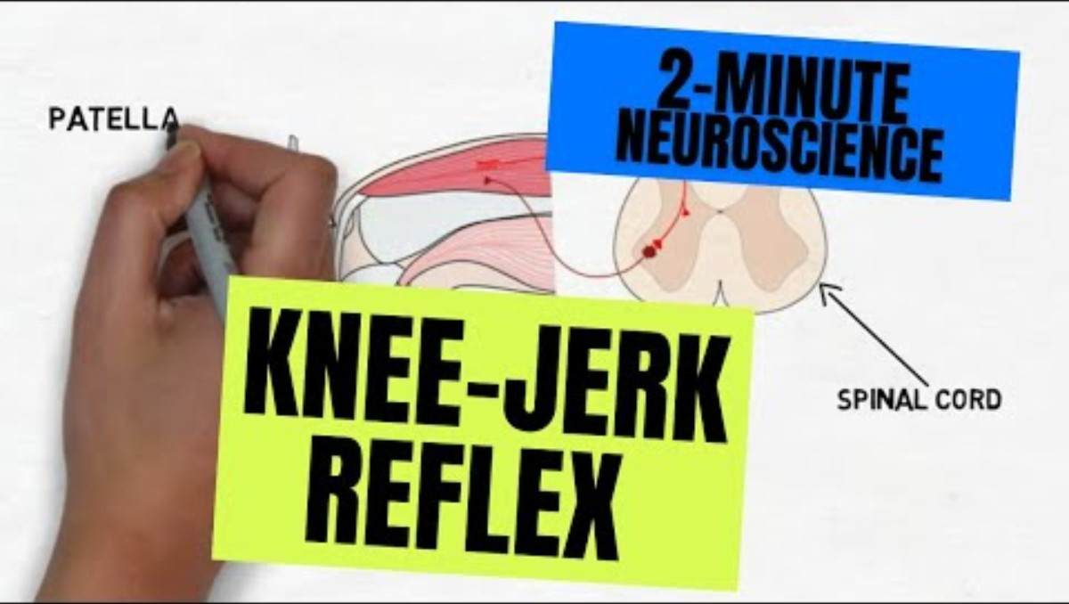
The Knee Jerk Reflex
Notes:
https://www.youtube.com/watch?v=c-dD0N53QRg

Slide 6
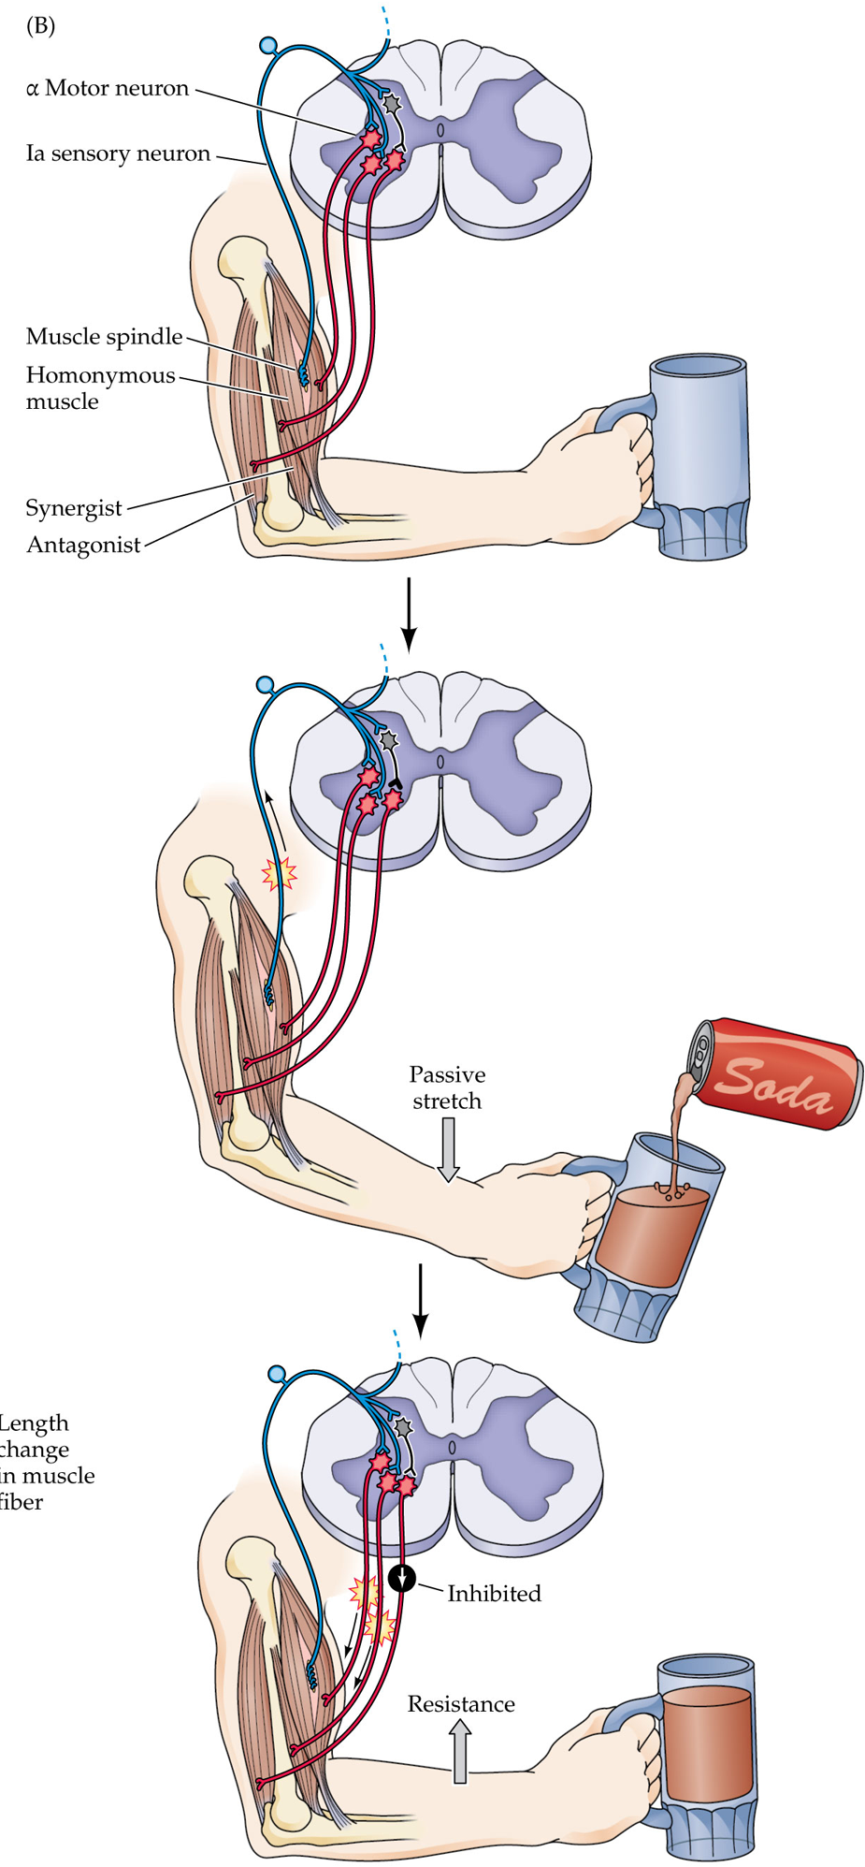
Another Example of Stretch Reflex
Adding liquid to the held mug stretches the bicep.
Muscle spindle activates and in turn activates the motor neuron innervating the bicep.
The afferent fiber also activates an inhibitory interneuron.
The interneuron inhibits the motor neuron innervating the tricep (antagonist)
Result: bicep contracts to counteract the added weight to the mug. Tricep remains lengthened.

Slide 7
Golgi Tendon Reflex
Negative Feedback System:
  muscle generates force deforming GTO Ib afferent receptors.
  Ib afferents can excite inhibitory interneurons in the spinal cord.
  Interneuron inhibits α motor neurons of the same muscle leading to decreased activation of the muscle
  There are also excitatory interneurons that when excited by Ib afferents then excite antagonist motor neurons.

Slide 8
Flexion Reflex
Nociceptors send Aδ fibers to dorsal horn interneurons
  Limb withdrawal
    activate ipsilateral excitatory interneurons leading to contraction of flexor muscle
    activate ipsilateral inhibitory interneurons to the extensor muscle
  Stabilize body via opposite contralateral response
    inhibit contralateral flexor muscle
    activate contralateral extensor muscle

Slide 9
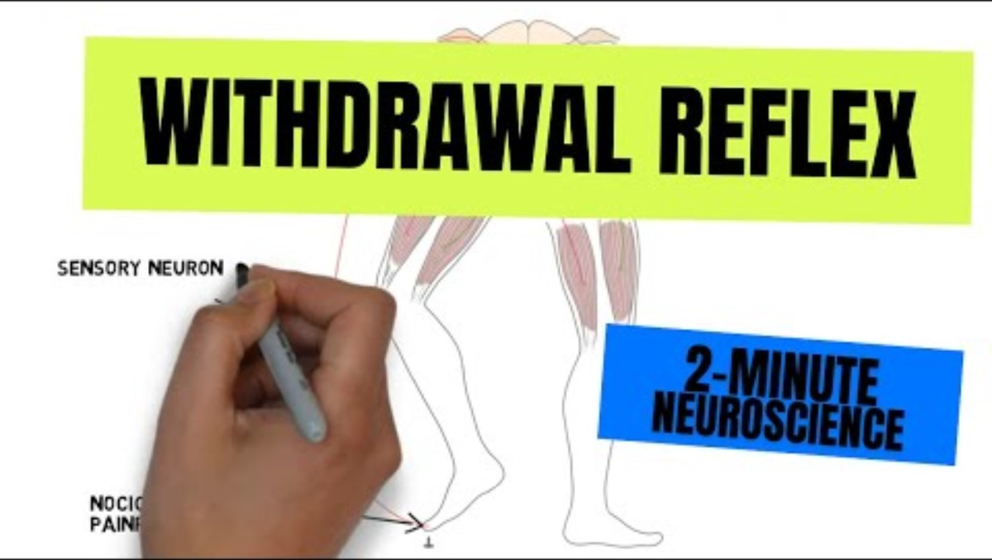
The Flexion (Withdrawal) Reflex
Notes:
https://www.youtube.com/watch?v=4oUCcIt3TtU

Slide 10
Comparing and Contrasting Spinal Reflexes
 | Stretch | Golgi Tendon Organ | Flexion
Circuit
Sensory Afferent Type
Resulting Muscle Movement
Stimulus

Slide 11

Central Pattern Generators (CPGs)
CPGs within local spinal cord circuits can control timing and coordination of complex movement patterns and adjust in response to changes.
  supports rhythmic motor behavior
https://tenor.com/search/white-cat-walking-gifs

Slide 12
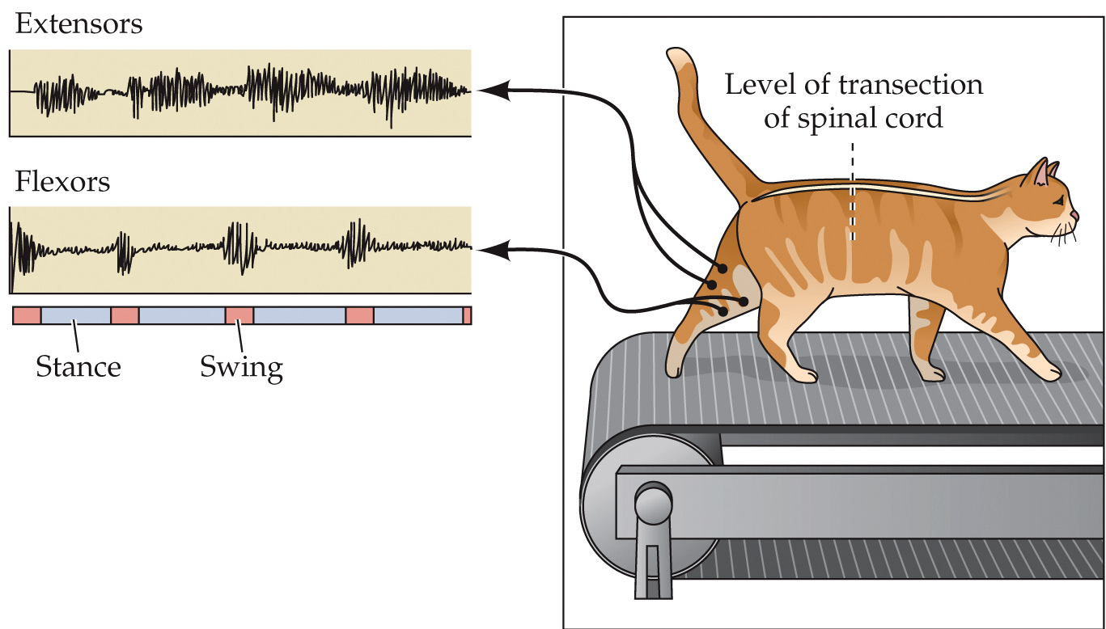
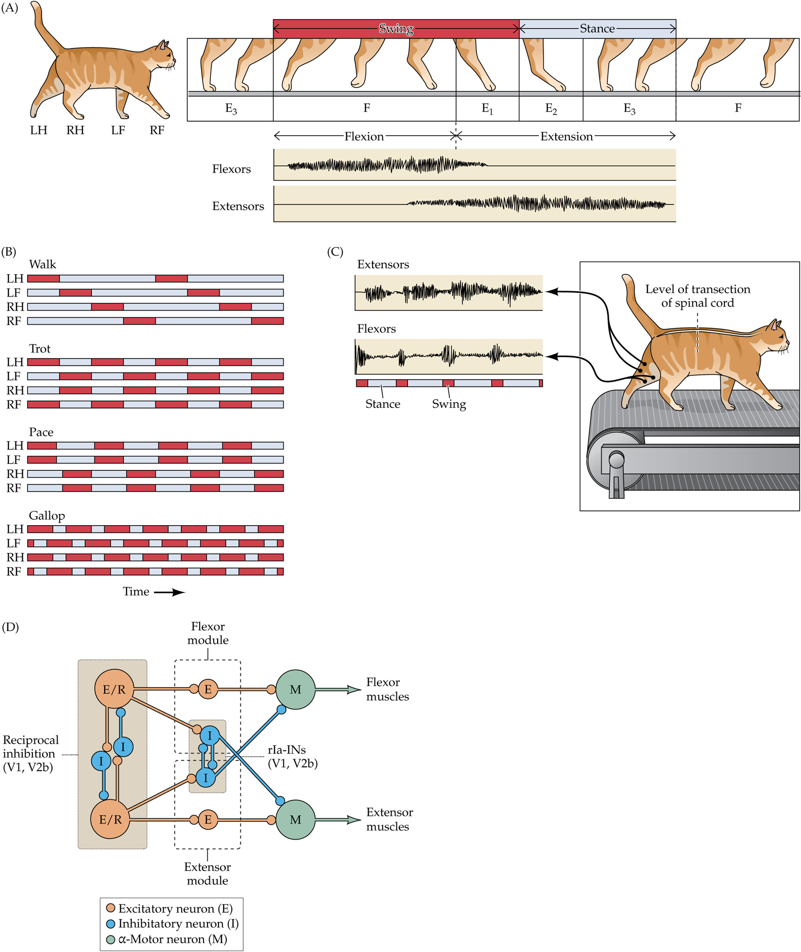
CPGs and Walking
2 phases:
  Stance: limb is extended and placed in contact with the ground
  Swing: limb is flexed, lifted and brought forward
Modules for flexion and extension receive input from excitatory rhythm generating interneurons, which are reciprocally inhibited by interneurons.
While higher regions contribute, they are not required.
  Stepping & pace changes can occur in fully spinally transected and decerebrate animals.

Slide 13
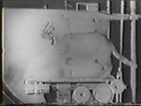
Notes:
Cat without a cerebrum/cortex

Slide 14
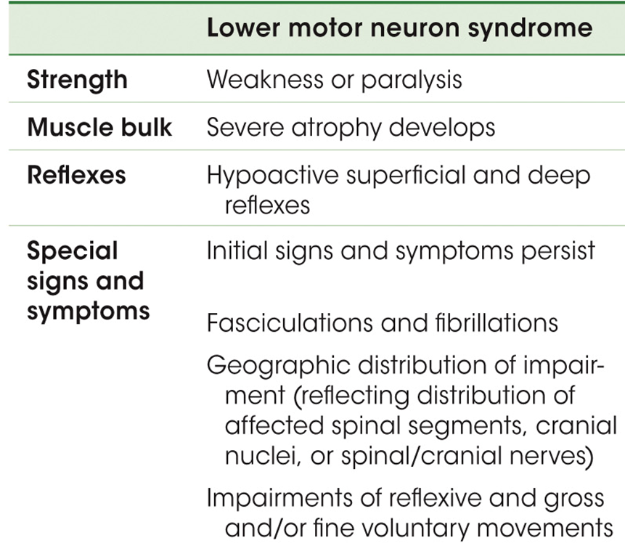
Signs of LMN Damage
Paralysis: loss of movement
Paresis: weakness of muscles
Fibrillations: spontaneous twitch associated with a denervated muscle fiber
Fasciculations: spontaneous twitches associated with pathological activity of injured motor neurons.

